Slide 1
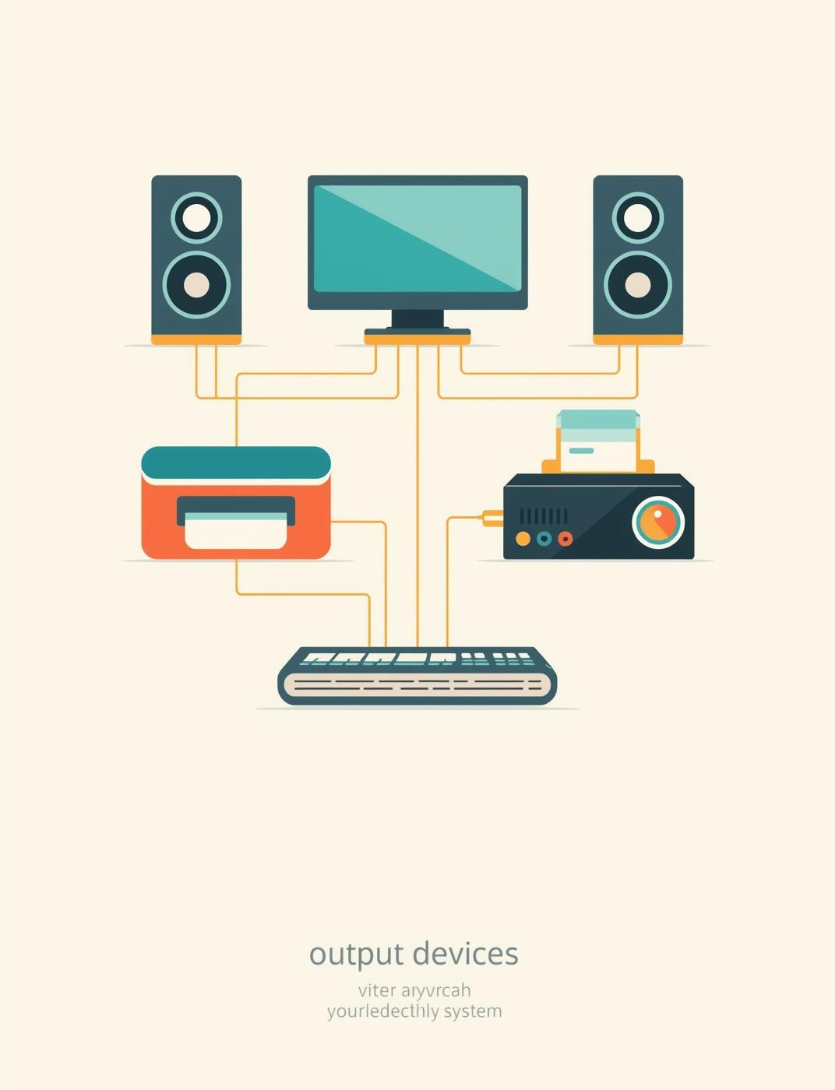
Output Devices
Bringing Digital Data to Life
Hana Aden
Seofch acedamy

Slide 2
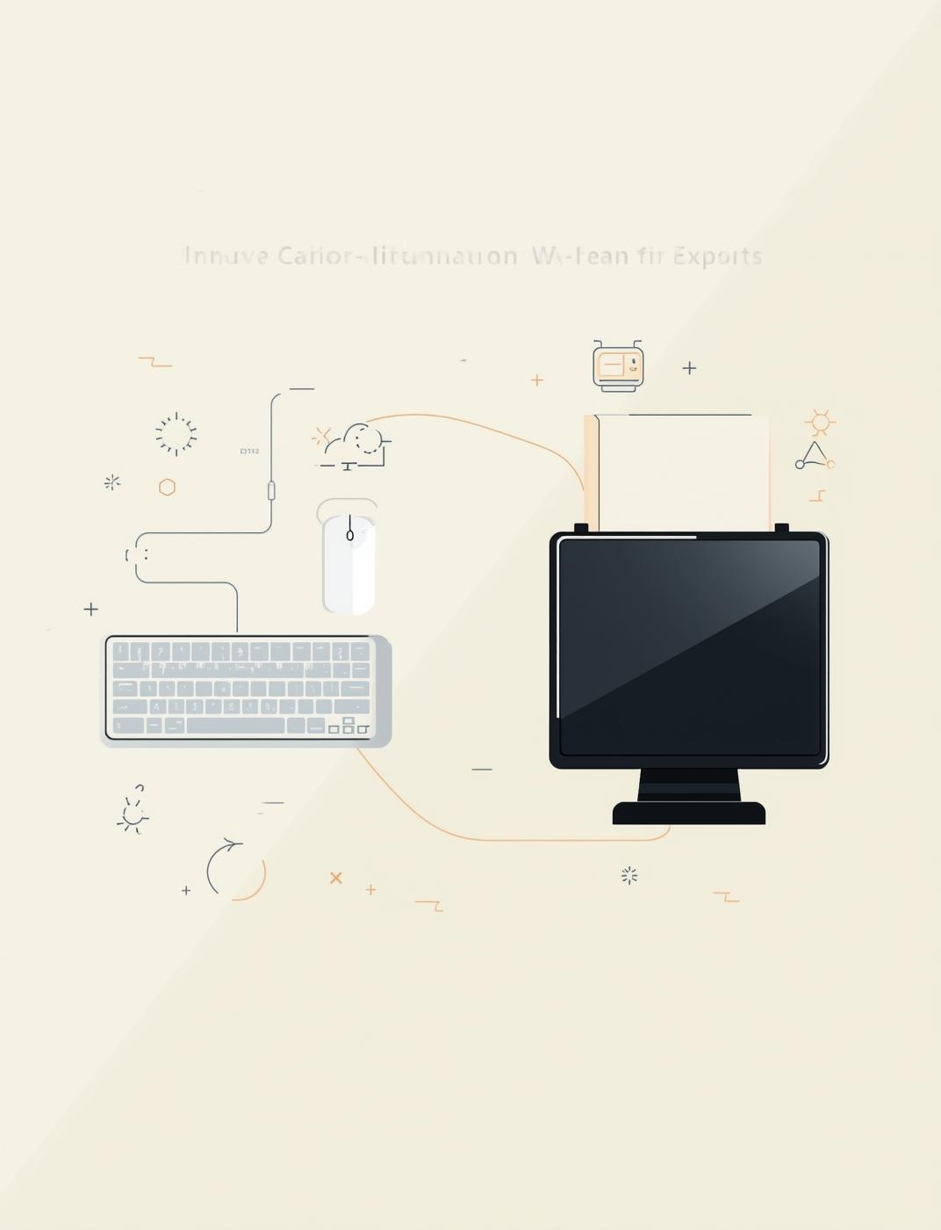

Introduction to Output Devices
Output devices are essential hardware components that convert digital signals from a computer into formats that are understandable to humans, enabling effective communication and interaction.

Slide 3

Importance of Output Devices
Visual Outputs
Support comprehension by displaying information clearly.
Audio Outputs
Enhance accessibility for users with auditory needs.
Understanding their critical role in technology
Hard Copy Outputs
Enable documentation and provide physical records easily.
Human-Computer Interaction
Enhance overall interaction and communication with computers.

Slide 4
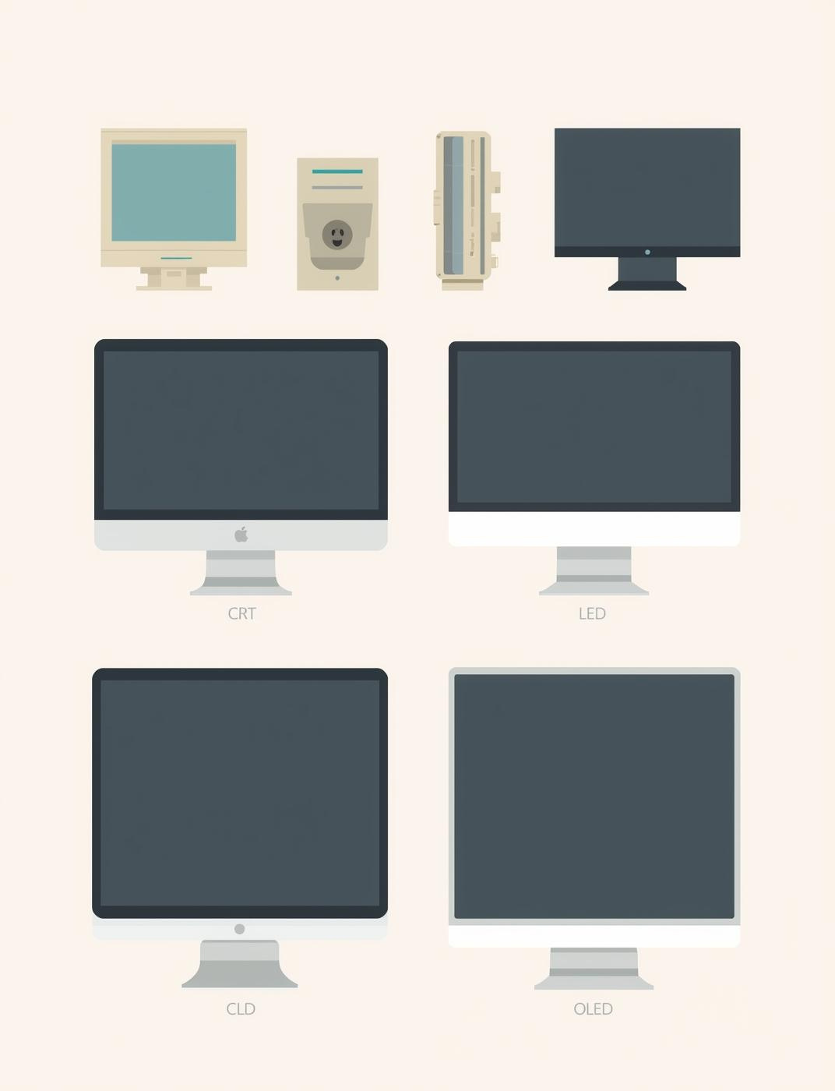

Monitor – Visual Output Device

Slide 5
Monitor Types
01
02
03
CRT
LCD
LED
Traditional display technology with bulkiness.
Slim and energy-efficient, widely used today.
Brighter and longer lifespan than previous types.

Slide 6


Key Functions
Monitors serve as essential output devices, facilitating visual representation of software, enabling users to interact with applications, and enhancing productivity across various tasks.

Slide 7
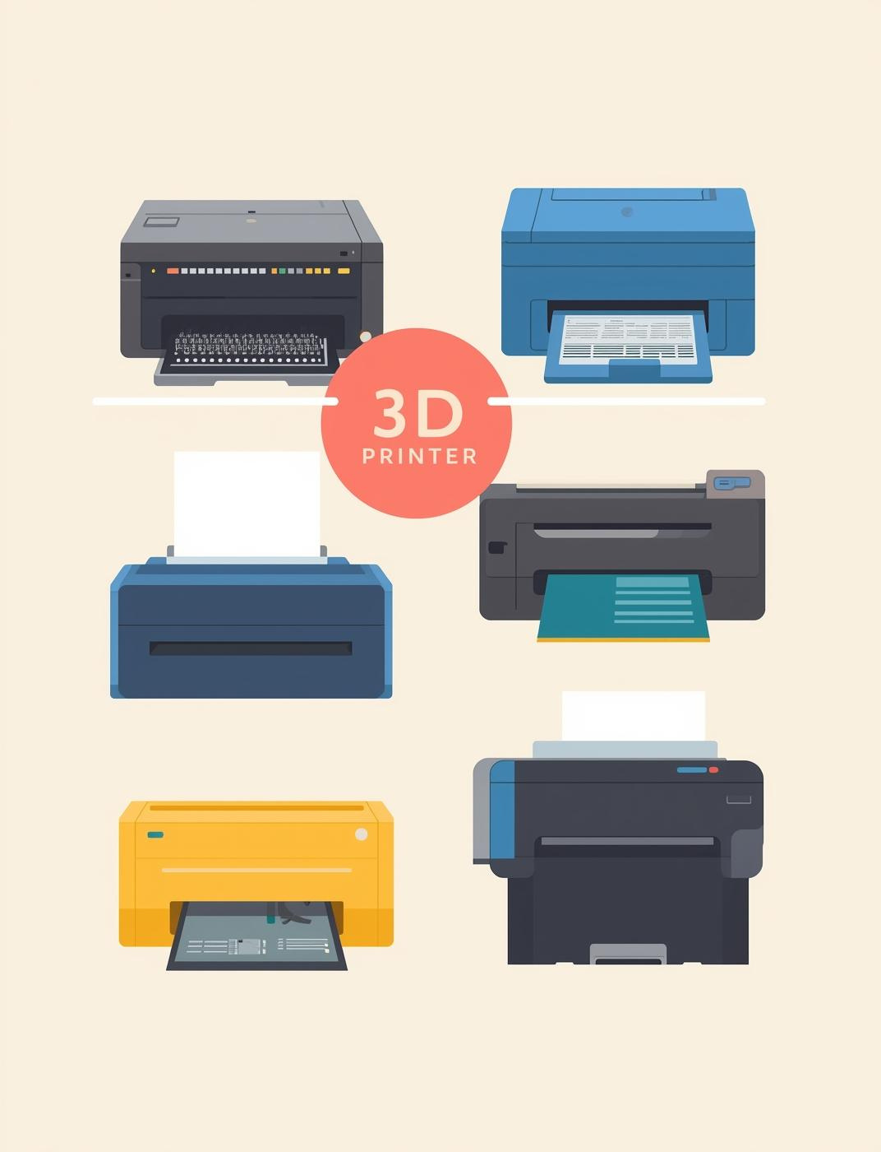
Types of Printers

Slide 8

Types of Printers
Impact Printers
Non-Impact Printers
Specialized Printers
Specialized printers, including thermal and 3D printers, utilize unique technologies, where thermal printers heat special paper to create images, and 3D printers build objects layer by layer.
Impact printers use physical impact to transfer ink onto paper, producing text and images through mechanisms like pins striking an ink ribbon, ideal for multi-part forms.
Non-impact printers create images without physical contact, using methods such as inkjet, where liquid ink is sprayed, and laser, which uses heat to fuse toner onto paper.

Slide 9

Functions of Printers
Printers play a crucial role in producing hard copies of documents, images, and charts, enabling easy sharing, documentation, and physical storage for various personal and professional needs.

Slide 10
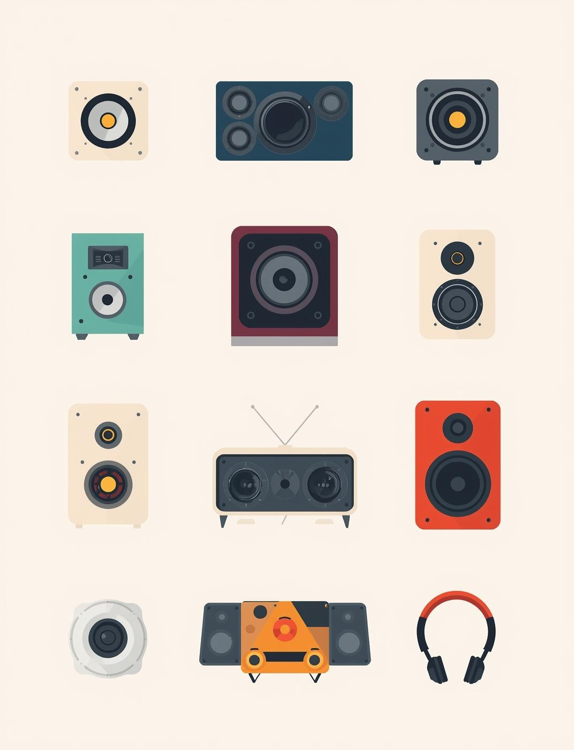
Speaker – Audio Output Device

Slide 11
Speaker Functions
Audio Playback
Plays various audio formats for entertainment and media.
Exploring the essential roles of speakers
Voice Communication
Enables voice interaction for calls and conferencing.
Accessibility Support
Assists users with auditory needs and requirements.
Application Areas
Used in multimedia, presentations, and various entertainment.

Slide 12
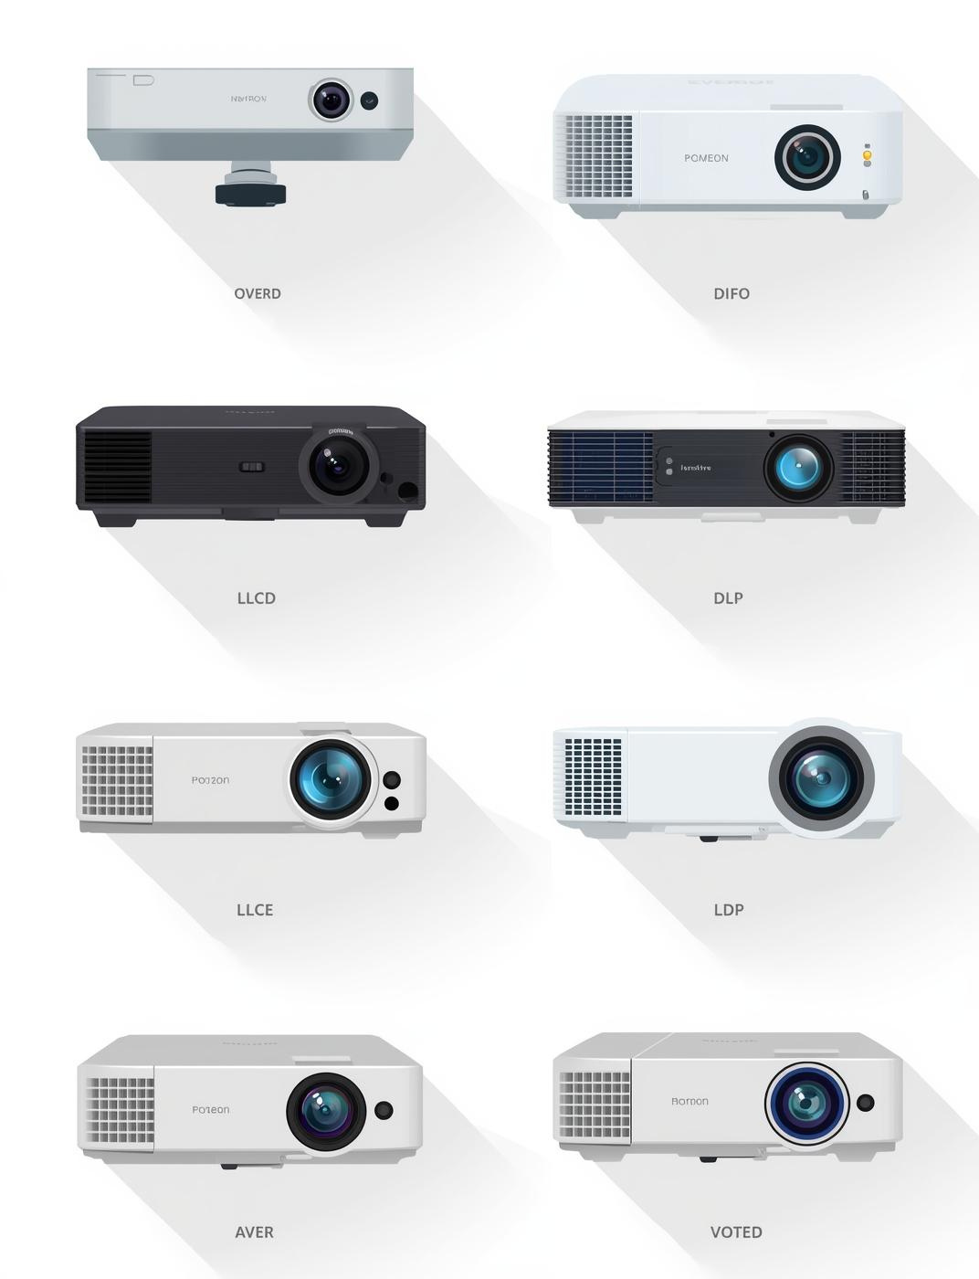
Projectors: Visual Output Devices

Slide 13
Types of Projectors
Overhead
Multimedia/Digital
LCD, DLP, LED
Multimedia projectors enable versatile presentations by connecting to computers or devices, displaying videos and graphics with high clarity and vibrant colors for engaging audiences.
LCD, DLP, and LED projectors employ advanced technologies for superior image quality, offering options for varying brightness and resolution suited for different environments and applications.
Overhead projectors utilize transparency sheets to project images onto a screen, making them suitable for basic presentations in classrooms or small meetings.

Slide 14
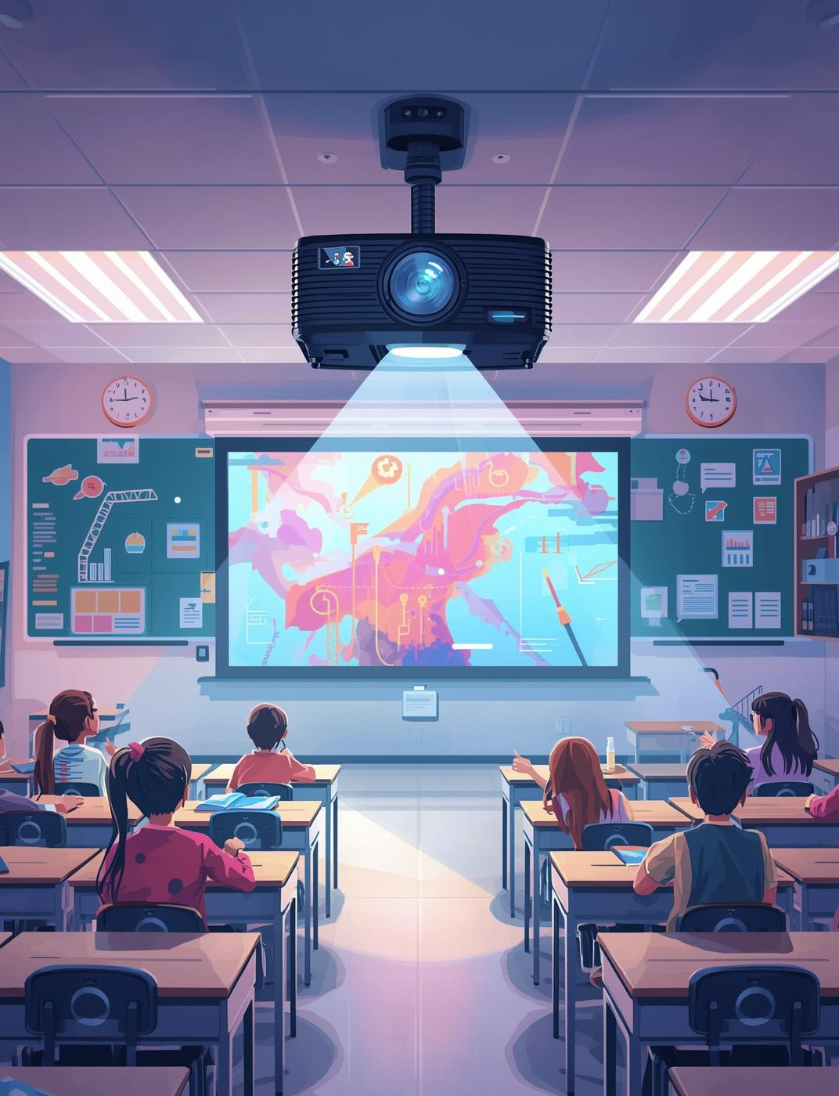
Functions of Projectors
Projectors are essential in educational settings, enabling interactive learning by projecting visuals for group discussions, presentations, and multimedia content, enhancing comprehension and collaboration among students.

Slide 15

Importance of Output Devices
Output devices play a critical role in converting digital data into understandable formats, supporting communication, enhancing productivity, and improving accessibility for all users in various settings.

